Slide 1
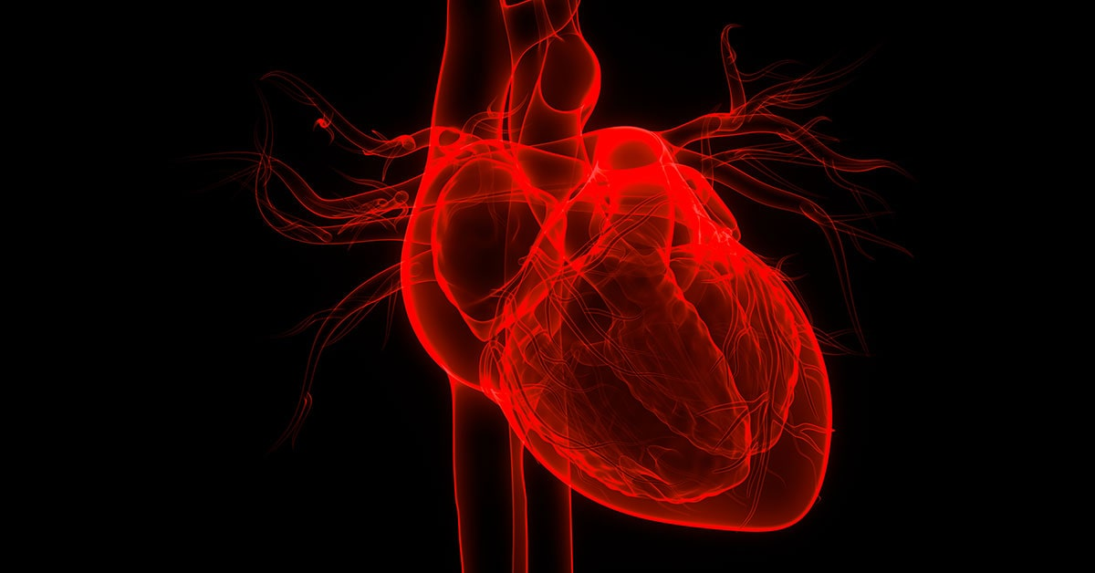
HEART FAILURE CLINICAL RECORDS
Presented by
Gulberin Heja BARAN

Slide 2

This presentation analyzes and explains the survival and death rates of heart attack patients according to various factors, how these factors affect heart failure. It shows how diseases such as anemia, diabetes, Heart blood pressure, and habits such as smoking affect a heart attack.
And it explains the connection of characteristics such as gender or age with these analyses.

Slide 3
According to the analysis in the first chart, the number of men who died due to a heart attack is higher than women. It shows that 65% of the people in this table are men and 35% are women.
In the next chart, we see that the number of men who have had a heart attack and survived is higher than women. According to the data we have obtained from these tables, in general, men are more likely to have a heart attack than women.

Slide 4
This table shows the distribution of the number of people who have a heart attack by age. Out of 94 people, 31 of them are under the age of 60, 13 of them are 60 years old and 52 of them are over 60 years old.
DEATH_EVENT | Dead
Row Labels | Count of DEATH_EVENT
42 | 1
45 | 6
46 | 1
48 | 2
49 | 1
50 | 8
51 | 1
53 | 1
54 | 1
55 | 3
57 | 1
58 | 2
59 | 3
60 | 13
60.667 | 1
62 | 1
65 | 8
68 | 2
69 | 2
70 | 7
72 | 5
73 | 1
75 | 6
77 | 1
80 | 5
82 | 3
85 | 3
86 | 1
87 | 1
90 | 2
94 | 1
95 | 2
Grand Total | 96
Row Labels | Average of age
Alive | 58.7619064
Dead | 65.21528125
Grand Total | 60.83389298
The average age of people who have died and survived a heart attack is as shown in the table above.
Based on the two tables, people over the age of 60 are more likely to have a heart attack.
Therefore, the average age of people who die is over 60 years old.

Slide 5
ANEMIA
This graphic shows those with and without anemia in men and women who have had a heart attack and survived.
It has been found that there is more anemia in the surviving men compared to the surviving women.
48% of people who die due to a heart attack have anemia, 52% do not have anemia.

Slide 6
DIABETES
Among people who have alive and died from a heart attack, men with diabetes are more than women. The percentage of men with diabetes is 56%, while women are 44%.
According to these data, the percentage of men who have diabetes and die is the same as women who have diabetes and die.

Slide 7
HIGH BLOOD PRESSURE
As can be seen in this table, the survival rate of people with HBP is lower than people without HBP.
In other words, high blood pressure has a significant impact on heart failure.
Of those who died of heart failure, 41% had high blood pressure, 59% did not.

Slide 8
SMOKING
The percentage of people who smoke and die and the percentage of people who smoke and alive are very close to each other. So this means that smoking is an important factor in heart failure.

Slide 9
Ejection-FRACTION
Ejection fraction refers to the percentage of how much blood your heart pumps with each contraction. If this happens below a certain percentage, it can lead to problems such as heart failure, heart attack. The ejection rate of a normal heart can be between 50% and 70%. if it is between 41% and 49%, it is considered borderline, but it is still dangerous, and if it is below 40%, it is considered very low.
As we can see in this table, the average ejection fraction percentage of deceased people is below 50% and that of living people is above 50%.

Slide 10
Average of ejection fraction according to smoking
The average ejection fraction of people who do not smoke is higher than those who smoke. The average of people who did not smoke and died was 34.36 , while the average of people who smoked and died was 31.5 .
This shows us that smoking affects the Ejection Fraction very much, and it may also increase the number of people who die from heart failure because of this
Row Labels | Average Of Ejection_fraction
Non-Smokers | 38.63054187
Alive | 40.68613139
Dead | 34.36363636
Smokers | 36.92708333
Alive | 39.39393939
Dead | 31.5
Grand Total | 38.08361204

